Slide 1

Right Access, Right Time:
Intelligent Extranet Control
A data – structure driven solution for secure temporary access

Slide 2

INTRODUCTION
The need for external users access the organization network infrastructure via the extranet must be managed to protect the internal network security. The strategy followed to allocate time expiration slots for accessing, uses the data structure of Min Heap.
Temporary access – with defined expiry times
Monitoring the users for suspicious activities
Reduces risks of manual way of handling
Min Heap tracks access and removal of expired users

Slide 3





ACCESS CHALLENGES
Overstayed Access
Suspicious activity recognition
Lack in ending session on time, access revoke failure.
Absence in finding abnormal activities and immediate removal of such users.
Error inclined/biased Manual assignments
System inability to assign and recognize users and allocate time expiration based on role policies

Slide 4
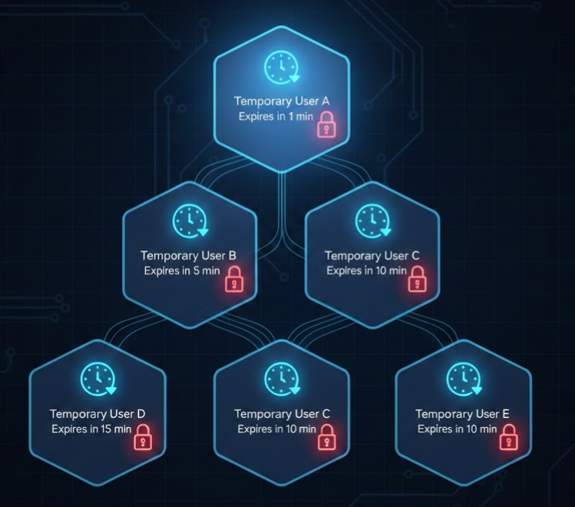
TIME-SMART ACCESS
The solution turns the manual control into automated, efficient and secure system with the help of a data structure.
A software-based automatic extranet access control system.
The system is Time- based.
Developed by using Min-Heap.

Slide 5
MIN HEAP : THE FOUNDATION
Prioritize the Earliest Expiry Time
Fast Insertion and Removal in Logarithmic time
Node Structure : User ID, Role, Expiry time & Access Scope
Optimal Ordering : Always keeps the earliest expiry at Root

Slide 6




JUSTIFICATION : WHY MIN HEAP ?
Min heap : The best option for a priority driven access control system.
Time Based Access
The temporary access of the system is time-based
Prioritize Early Expiry
With the Min heap the users are prioritized by earliest expiry time.
Fast Scanning
Not all users need to be scanned
Efficient Operations: Less Time Complexity.
Insert, Delete O (log n)
Search O (1)

Slide 7
RIGHT TOOL FOR THE JOB

Slide 8

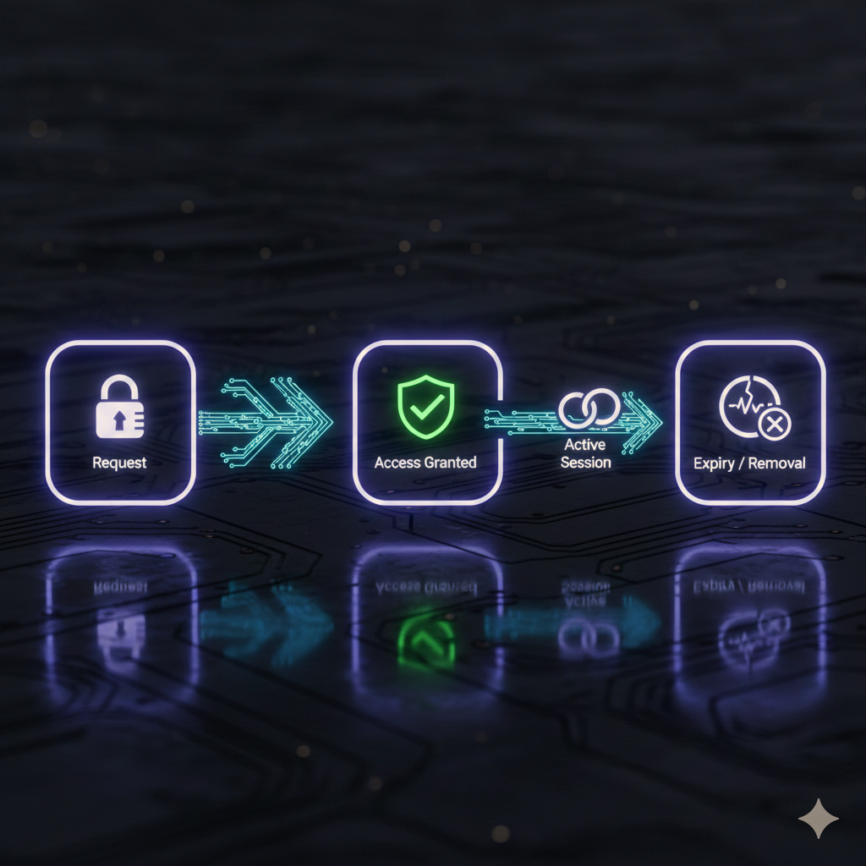
THE CONTROL HUB
This virtual system is designed to manage temporary access for extranet users efficiently and securely while operating continuously.
Heap Node : One node per user
Key of the heap : Expiry Time
Root : Next user to be expired
Access Revocation : Automatic
Unusual Behavior : Immediate user removal
Access Duration : Automatic based on the role
Time Extension : Upon user request

Slide 9





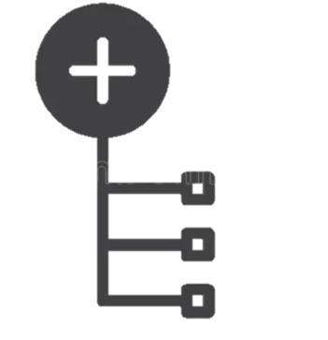

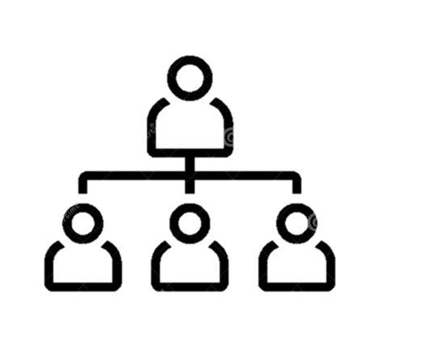


HOW ACCESS FLOWS
Access Allocation
Expiry Enforcement & Extension
Unusual Behavior Detection
01 :Digital Form
(User Info)
02 :Generate UID & Expiry Time
03 :Create Heap Node
04 :Insert node into Heap
05 : Enable User Access
01 :Check the Root for next Expiry.
02 :Current Time >= Expiry -5
No
Yes
03 :Send Extension Request
04 :User Response
Yes Update expiry time
Rebalance heap
No Remove Root Node
Revoke Access
01 :Receive Detected UID
02 :Locate the UID in heap
03 :Remove Node from heap
04 :Rebalance Heap
05 :Revoke Access Immediately
Continue Polling

Slide 10

CONCLUSION
The approach of addressing the issue, transforming the manual way of extranet access for expiry-time, priority-based user allocation and abnormal activities are solved by applying the Min Heap as the solution. Additionally, it is a depiction of how data structure and algorithm assists in providing a better solution for a network problem, exists within the real world.

